Slide 1
Clustering Methods
Chi-Hyuck Jun
chjun@postech.ac.kr

Slide 2
Introduction

Slide 3
What Is Clustering ?
Clustering is a process of partitioning a set of data (or objects) into a set of meaningful sub-classes, called clusters.
Help users understand the natural grouping or structure in a data set.
Clustering is a unsupervised classification with no predefined classes.
Used either as a stand-alone tool to get insight into data distribution or as a preprocessing step for other algorithms.
Cluster: a collection of data objects that are “similar” to one another and thus can be treated collectively as one group.

Slide 4
What Is Good Clustering?
A good clustering method will produce high quality clusters in which:
the intra-class (that is, intra-cluster) similarity is high.
the inter-class similarity is low.
The quality of a clustering result also depends on both the similarity measure used by the method and its implementation.
The quality of a clustering method is also measured by its ability to discover some or all of the hidden patterns.

Slide 5
Requirements of Clustering in Data Mining
Scalability
Dealing with different types of attributes
Discovery of clusters with arbitrary shape
Minimal requirements for domain knowledge to determine input parameters
Able to deal with noise and outliers
Insensitive to order of input records
High dimensionality
Interpretability and usability.

Slide 6
Examples of Clustering Applications
Marketing: Help marketers discover distinct groups in their customer bases, and then use this knowledge to develop targeted marketing programs.
Insurance: Identifying groups of motor insurance policy holders with a high average claim cost.
Land use: Identification of areas of similar land use in an earth observation database.
City-planning: Identifying groups of houses according to their house type, value, and geographical location.
Document clustering: Automatic document organization, topic extraction and fast information retrieval or filtering.

Slide 7
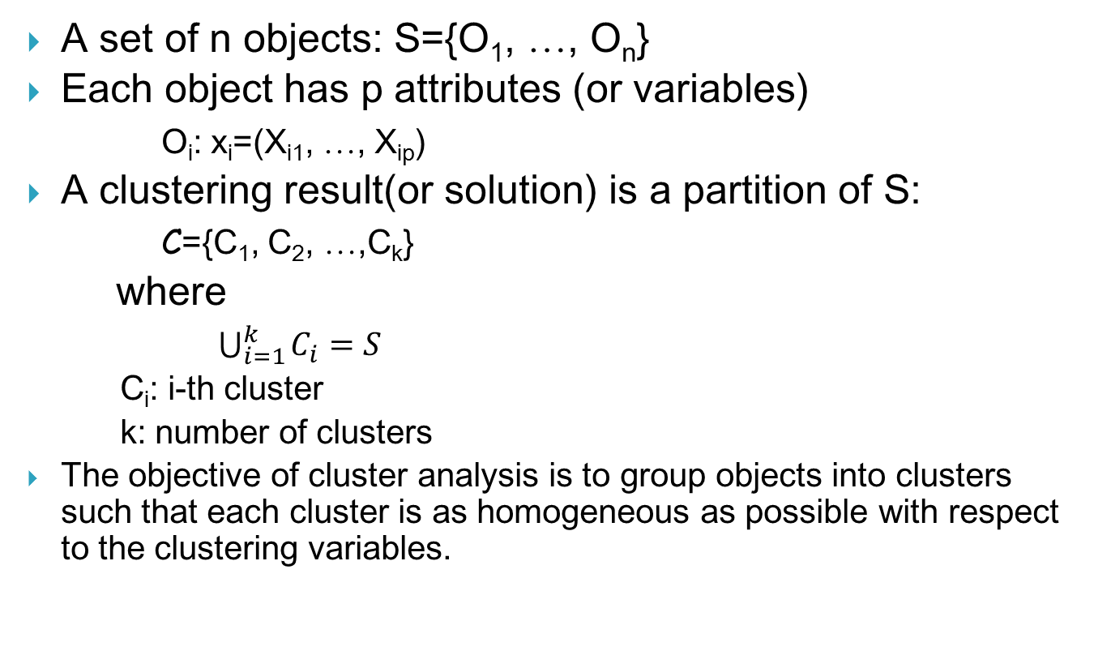
Mathematical Formulation
A set of n objects: S={O₁, …, O_{n}}
Each object has p attributes (or variables)
O_{i}: x_{i}=(X_{i1}, …, X_{ip})
A clustering result(or solution) is a partition of S:
C={C₁, C₂, …,C_{k}}
where
$\bigcup_{i=1}^{k}{C_{i}}=S$
C_{i}: i-th cluster
k: number of clusters
The objective of cluster analysis is to group objects into clusters such that each cluster is as homogeneous as possible with respect to the clustering variables.

Slide 8
Steps in Cluster Analysis
1. Select a measure of similarity
2. Select clustering method: hierarchical/non-hierarchical
3. Decide #clusters
4. Interpret the result
object
High
Income
variables
Low
Low
High
Brand loyalty

Slide 9
Distance or Dissimilarity Measures
Euclidean distance
High
Income
Low
Low
High
Brand loyalty

Slide 10
Euclidean Distance - example
Income
1
d
=
d
=
(
130
−
150
)
2
+
(
55
−
50
)
2
=
20
.
6
2
12
21
4
3
5
Brand Loyalty

Slide 11
Other Distance Measures
Minkowski distance
Standardized Minkowski distance
Mahalanobis distance
Correlation coefficient (similarity between Obj i & j)

Slide 12
Similarity/Distance Measures for Categorical Variables
Binary Variables
Simple matching
Jaccard
 | 에서 1 | 에서 0
에서 1 | a | b | a+b
에서 0 | c | d | c+d
 | a+c | b+d | a+b+c+d=p

Slide 13
Similarity/Distance Measures for Categorical Variables (cont’d)
Ordinal Variables
Nominal Variables

Slide 14
Similarity/Distance Measures for Categorical Variables (cont’d)
Between Two Objects having mixed types
Previous measures have values ranging between 0 and 1.So, we need a similar measure for a continuous variable when an object consists of mixed types of variables.
Suggest using the following measure for a continuous variable:
Combining Measure:

Slide 15
Hierarchical Clustering

Slide 16
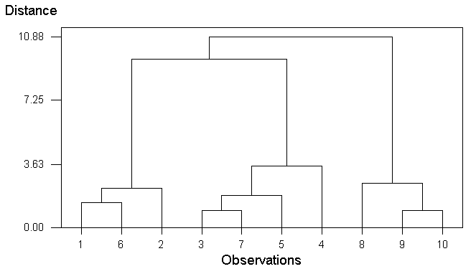
Hierarchical Cluster Methods
Hierarchical Cluster Procedures
Agglomerative method or Divisive method
The clustering process can be represented by a dendrogram
Useful when the number of objects is relatively small

Slide 17
Distance Measures between clusters
Comparison of distance measures
Complete linkage or
Farthest neighbor
Single linkage or nearest neighbor
Centroid
Minimum of all possible pairs
Maximum of all possible pairs

Slide 18
Distance Measures between clusters
: Distance between clusters C_{i} and C_{j}
Single Linkage
Complete Linkage
Average Linkage
|C_{i}|: #objects in C_{i}
Centroid Linkage

Slide 19
Clustering Algorithms
Hierarchical Cluster Procedures (Agglomerative)
Single Linkage or Nearest-neighbor Method
Complete Linkage or Farthest-neighbor Method
Average Linkage Method
Centroid Method
Ward’s Method

Slide 20
Single Linkage Method(1/4)
Based on the minimum distance. Two objects separated by the shortest distance are placed in the first cluster. Then, next shortest distance is found, etc.
1
2
4
5
3

Slide 21
Single Linkage Method(2/4)
1
2
4
5
3

Slide 22
Single Linkage Method(3/4)
1
2
4
5
3
1
2
4
5
3

Slide 23
Single Linkage Method(4/4)
Dendrogram
4
7.8
18.6
5
42.4
3
20.6
1
2

Slide 24
Clustering Algorithm of Linkage Methods
Step 0
- Consider each object as one cluster.
- k=n
Step 1
- Compute for every pair of clusters.
- Find the minimum distance and combine two clusters as a single cluster.
-
Step 2 :
- If k=1, stop.
- Otherwise, repeat step 1.

Slide 25
Average Linkage Method – example
Example- PC experience year and weekly hrs with PC
Use Average Linkage Method.
Iteration 0.
각 객체 Oj(j=1,2,…,10)를 하나의 군집으로 간주한다.
- 군집결과 : C1={1},C2={2},…C10={10}
- k(군집의 수) =10
O1
O2
O3
O4
O5
O6
O7
O8
O9
O10
Exper yr
6
8
14
11
15
7
13
5
3
3
Weekly hr
14
13
6
8
7
15
6
4
3
2

Slide 26
Average Linkage Method – example
군집간 유사성 척도 D(Ci,Cj)
Iteration 1.
—거리가 최소인 두 군집 C9과 C10을 묶어 하나의 군집으로 만든 후 군집 결과를 수정한다. 이를 새로운 군집 C9이라 하자.
—k=9 : C1={1}, C2={2}, C3={3}, C4={4}, C5={5}, C6={6}, C7={7}, C8={8}, C9={9,10}
C1
C2
C3
C4
C5
C6
C7
C8
C9
C2
2.24
C3
11.31
9.22
C4
7.81
5.83
3.61
C5
11.40
9.22
1.41
4.12
C6
1.41
2.24
11.40
8.06
11.31
C7
10.63
8.60
1.00
2.83
2.24
10.82
C8
10.05
9.49
9.22
7.21
10.44
11.18
8.25
C9
11.40
11.18
11.40
9.43
12.65
12.65
10.44
2.24
C10
12.37
12.08
11.70
10.00
13.00
13.60
10.77
2.83
1.00

Slide 27
Average Linkage Method – example
Iteration 2.
새로운 군집들에 대한 D(Ci,Cj)
—군집사이의 거리가 최소인 두 군집, C3과
C7이 묶여져서 새로운 군집 C3이 된다.
—k=8 : C1={1}, C2={2}, C3={3,7}, C4={4},
C5={5}, C6={6}, C7={8}, C8={9,10}
Iteration 3.
—군집사이의 거리가 최소인 두 군집, C1과
C6이 묶여져서 새로운 군집 C1이 된다.
—k=7 : C1={1,6}, C2={2}, C3={3,7}, C4={4},
C5={5}, C6={8}, C7={9,10}
C1
C2
C3
C4
C5
C6
C7
C8
C2
2.24
C3
11.31
9.22
C4
7.81
5.83
3.61
C5
11.40
9.22
1.41
4.12
C6
1.41
2.24
11.40
8.06
11.31
C7
10.63
8.60
1.00
2.83
2.24
10.82
C8
10.05
9.49
9.22
7.21
10.44
11.18
8.25
{9,10}
11.89
11.63
11.55
9.72
12.82
13.13
10.61
2.53
C1
C2
{3,7}
C4
C5
C6
C7
C2
2.24
{3,7}
11.31
9.22
C4
7.81
5.83
3.22
C5
11.40
9.22
1.83
4.12
C6
1.41
2.24
11.11
8.06
11.31
C7
10.05
9.49
8.73
7.21
10.44
10.82
{9,10}
11.89
11.63
11.08
9.72
12.82
13.13
2.53

Slide 28

Average Linkage Method – example
Iteration 4.
k=6 : C1={1, 6}, C2={2}, C3={3, 5, 7}, C4={4}, C5={8}, C6={9, 10}
Iteration 5.
k=5 : C1={1, 2, 6}, C2={3, 5, 7}, C3={4}, C4={8}, C5={9, 10}
Iteration 6.
k=4 : C1={1, 2, 6}, C2={3, 5, 7}, C3={4}, C4={8, 9, 10}
Iteration 7. Dendrogram
k=3 : C1={1, 2, 6}, C2={3, 4, 5, 7}, C3={8, 9, 10}
Iteration 8.
k=2 : C1={1, 2, 3, 4, 5, 6, 7}, C2={8, 9, 10}
Iteration 9.
k=1 : C1={1, 2, 3, 4, 5, 6, 7, 8, 9, 10}
Distance btwn clusters
❒
 | C1={1,2,6} | C2={3,4,5,7}
C2={3,4,5,7} | 9.64
C3={8,9,10} | 11.56 | 10.38
❑
❐
■
□
●
❍


Iteration 7에서 얻어진 3개의
군집이 적절한 clustering solution

Slide 29
Ward’s Method (2/6)
Under a clustering result C={C₁, C₂, …,C_{k}}
Error sum of squares for cluster C_{i}
Total within sum of squares
When combining C_{i} and C_{j}:
Note that
SSW(C) < SSW(C’)

Slide 30
Clustering Algorithm of Ward’s Method(2/6)
Step 0
Consider each object as one cluster.
k=n
Step 1
Compute new SSW for every pair of clusters assuming they are combined.
Find the minimum SSW and combine two clusters as a single new cluster. Update the clustering result.
Step 2 : If k=1, stop.
Otherwise, repeat step 1.

Slide 31
Ward’s Method(3/6)
Example
# violations and driving experience
Iteration 0.
k=8 : C1={1}, C2={2}, C3={3}, C4={4}, C5={5}, C6={6}, C7={7}, C8={8}
Iteration 1.
두개의 군집씩을 통합할 때 산출되는 전체제곱합(SSW)
— combining C2 and C7 minimizes SSW
new cluster : C2
— k=7 : C1={1}, C2={2, 7}, C3={3}, C4={4}, C5={5},
C6={6}, C7={8}
O1
O2
O3
O4
O5
O6
O7
O8
experience
(X1)
4
20
3
19
17
8
19
18
violation
(X2)
15
13
13
4
17
11
12
6
 | C1 | C2 | C3 | C4 | C5 | C6 | C7
C2 | 130.0 | •
C3 | 2.5 | 144.5 | •
C4 | 173.0 | 41.0 | 168.5 | •
C5 | 86.5 | 12.5 | 106 | 86.5 | •
C6 | 16.0 | 74.0 | 14.5 | 85 | 58.5 | •
C7 | 117.0 | 1.0 | 128.5 | 32 | 14.5 | 61 | •
C8 | 138.5 | 26.5 | 137 | 2.5 | 61 | 62.5 | 18.5

Slide 32
Ward’s Method(4/6)
Example(cont’d)
Iteration 2.
k=6 : C1={1}, C2={2, 7}, C3={3}, C4={4, 8}, C5={5},
C6={6}
Iteration 3.
k=5 : C1={1, 3}, C2={2, 7}, C3={4, 8}, C4={5}, C5={6}
 | C1 | C2 | C3 | C4 | C5 | C6
C2 | 165.33 | •
C3 | 3.50 | 182.66 | •
C4 | 174.00 | 49.33 | 169.50 | •
C5 | 87.50 | 18.67 | 107.00 | 87.50 | •
C6 | 17.00 | 90.67 | 15.50 | 86.00 | 59.50 | •
C7 | 139.50 | 30.67 | 138.00 | 3.50 | 62.00 | 63.50
 | C1 | C2 | C3 | C4 | C5
C2 | 167.83 | •
C3 | 6.00 | 185.16 | •
C4 | 210.33 | 60.75 | 206.33 | •
C5 | 90.00 | 21.17 | 109.50 | 101.00 | •
C6 | 19.50 | 93.17 | 18.00 | 101.00 | 62.00

Slide 33
Ward’s Method(5/6)
Example(cont’d)
Iteration 4.
k=4 : C1={1, 3}, C2={2, 5, 7}, C3={4, 8}, C4={6}
Iteration 5.
k=3 : C1={1, 3, 6}, C2={2, 5, 7}, C3={4, 8}
 | C1 | C2 | C3 | C4
C2 | 264.25 | •
C3 | 312.00 | 63.25 | •
C4 | 133.50 | 23.67 | 103.50 | •
C5 | 25.50 | 95.67 | 103.50 | 64.50
 | C1 | C2 | C3
C2 | 299.70 | •
C3 | 329.67 | 120.9 | •
C4 | 43.17 | 115.75 | 121.17

Slide 34
Ward’s Method(6/6)
Example(cont’d)
Iteration 6.
k=2 : C1={1, 3, 6}, C2={2, 4, 5, 7, 8}
Iteration 7.
k=1 : C1={1, 2, 3, 4, 5, 6, 7, 8}
 | C1 | C2
C2 | 324.83 | •
C3 | 338.67 | 140.40
 | C1
C2 | 499.88

Slide 35
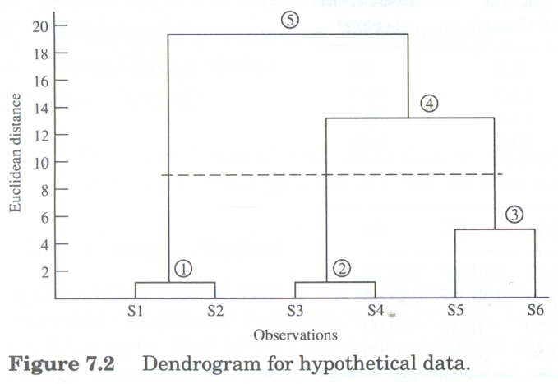
Decision on the number of clusters – Use of Dendrogram
CL1
CL2
CL3
CL5
CL4

Slide 36
Decision on the number of clusters (cont’d)
Root-mean-square standard deviation of the new cluster ;
RMSSTD
R²
Semipartial R-squared (SPR)
Distance between clusters
Loss of homogeneity

Slide 37
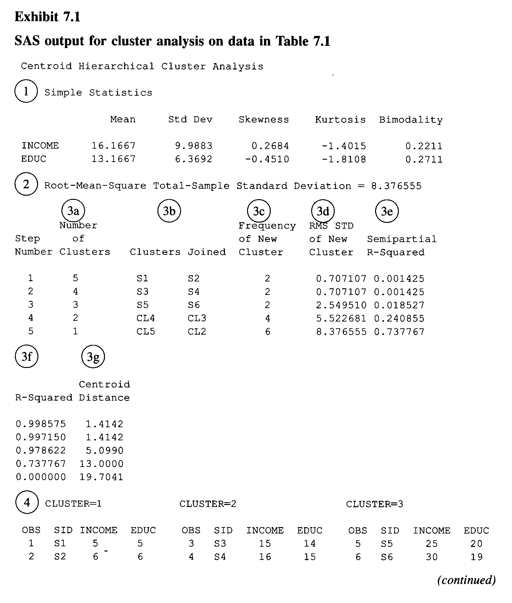

Slide 38
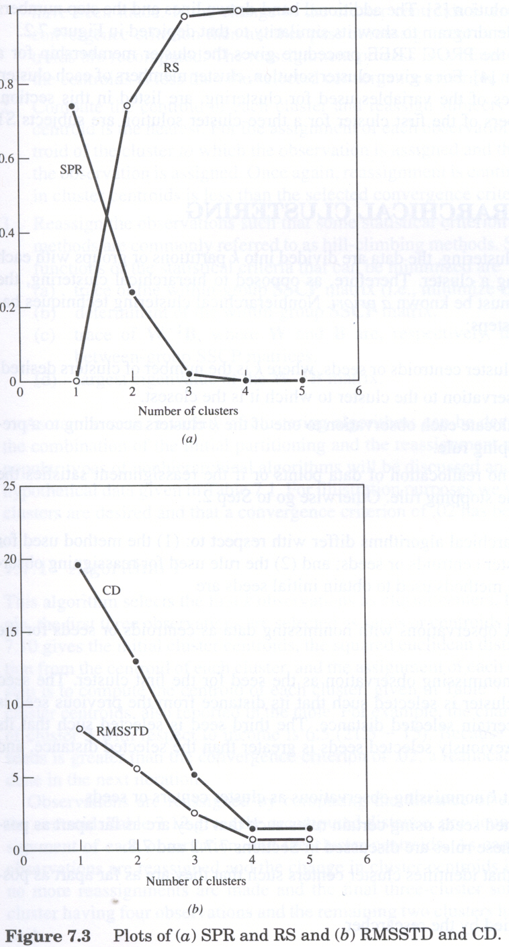
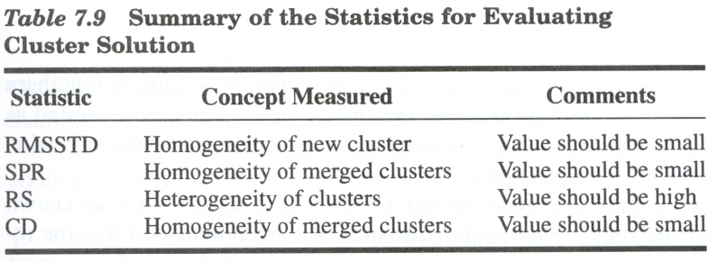
Decision on the number of clusters
“Big” change when going from 3-cluster to 2-cluster solution.

Slide 39
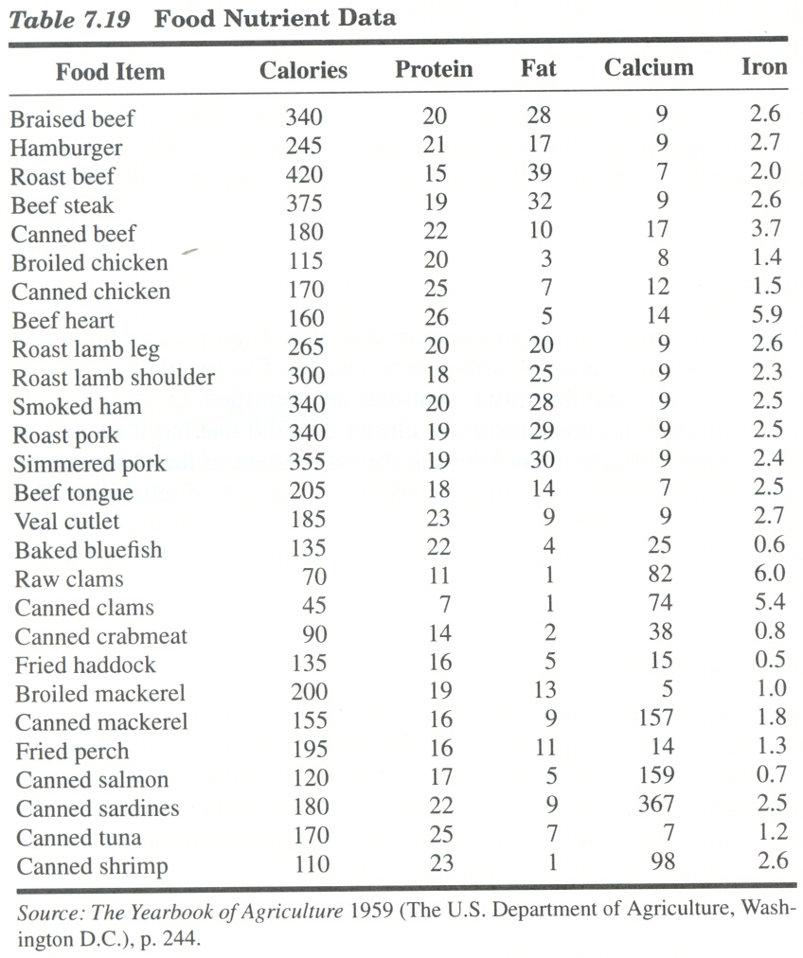
Example 2 – Food Nutrient Data

Slide 40
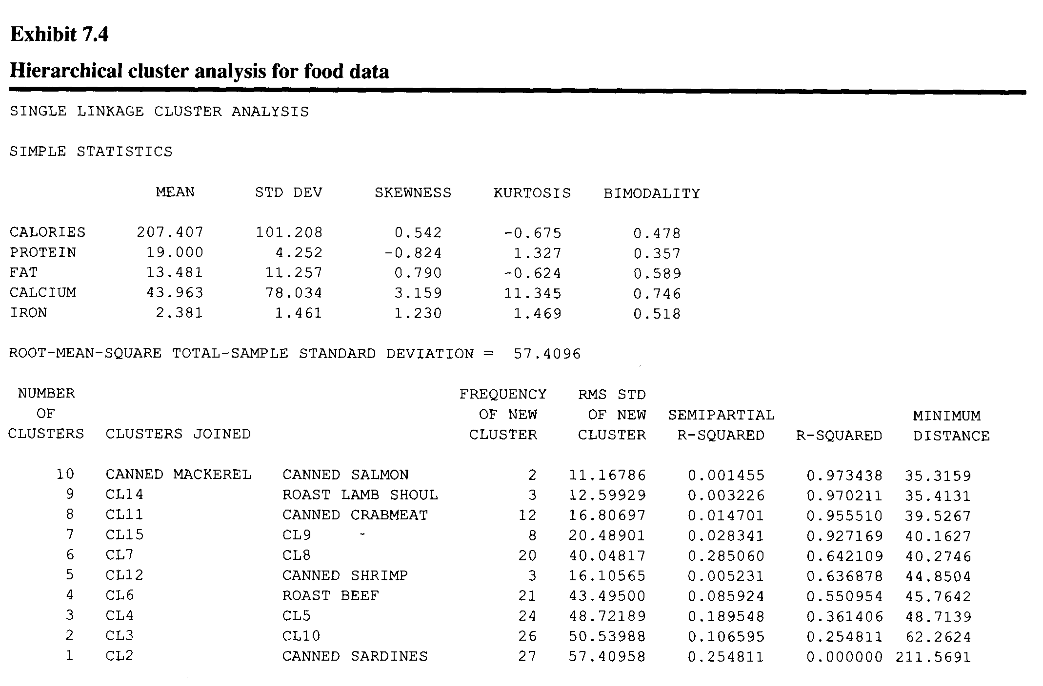

Slide 41
Cluster Analysis Plots: R-sq & RMSSTD

